Slide 1

ICIC Bank Managemet System
Harish Rewatkar
© All rights reserved by Fireblaze Technologies Pvt. Ltd.

Slide 2
Problem Statement
The Bank wants to build the database for their customer and employees with all the details like creating an account in a bank type of account which helps the bank to retrieve the data on one click so they can find out the day to day update easily on their database.
© All rights reserved by Fireblaze Technologies Pvt. Ltd.

Slide 3
About the Data
In this hospital management system, I have created many tables are as follows : Database name : ICIC Bank Managemnt System
Table 1 : Account type(Col : Account no. (Primary), Type Account, Manager id, Department name, opening date)
Table 2 : Department (Col : Department id (Primary), Department name, Manager id, Employee id, Account no. (Foreign))
© All rights reserved by Fireblaze Technologies Pvt. Ltd.

Slide 4
Table 3 : Bank Details (Col : Branch code (Primary), Address, Branch name, State, Department id (Foreign))
Table 4 : Job Details (Col : Job id (Primary), Department id (Foreign), Branch code (Foreign))
Table 5 : Employees (Col : Employee id (Primary), First name, Department id (Foreign), Manager id, Job id (Foreign), Email, Hire Date, Phone no., Salary)
Table 6 : Customer (Col : Account no. (Primary), First name, City, Branch code (Foreign), Employee id (Foreign), Phone no., ATM no., Expiry date, Pin no. )

Slide 5
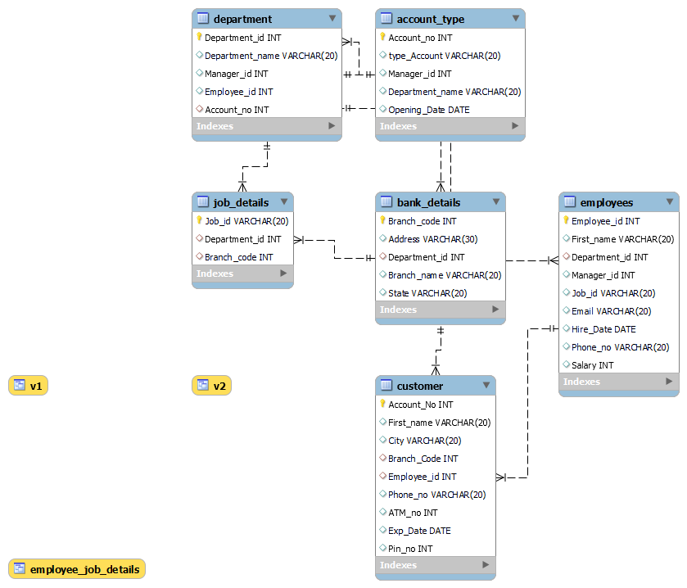
Entity Relationship Solution

Slide 6
Proposed Solution
By using this database we can study SWOT analysis of ICIC BANK.
To identify the probable area of improvement to make recruitment and selection procedure more effective.
© All rights reserved by Fireblaze Technologies Pvt. Ltd.

Slide 7
Conclusion
Operational effectiveness, internal efficiency.
The ability to easily search across and retrieve relevant information.
© All rights reserved by Fireblaze Technologies Pvt. Ltd.

Slide 8
Future Scope
The use of technology has brought a revolution in the working style of the banks. Nevertheless, the fundamental aspects of banking i.e. Trust and the confidence of the people in the institution remain the same.
© All rights reserved by Fireblaze Technologies Pvt. Ltd.

